Slide 1
New Employee
Safety Orientation
General Industry

Slide 2
Injury Statistics
5,070 fatal work injuries were recorded in the U.S. in 2024.
Transportation incidents were the leading cause of death in 2024, resulting in 38.2% of all work-related deaths.
Slips, trips, and falls accounted for 16.6% of work-related fatalities in 2024.
Reference: www.bls.gov/news.release/pdf/cfoi.pdf

Slide 3

Your Role in Safety
    Our goal as a company is to achieve safe work practices to help create a safe environment for everyone. Your role in safety is to:
    Participate in safety training.
    Identify hazards.
    Report hazards, incidents, and near misses.
    Maintain an attitude of safety.
    Ask for help.
Reference: www.osha.gov/safety-management/worker-participation

Slide 4

Hand Tool Safety
Keep all tools in good condition with regular maintenance.
Use the right tool for the job.
Examine each tool for damage before use and do not use if damaged.
Operate each tool according to the manufacturer’s instructions.
Use correct personal protective equipment when operating tools.
Reference: www.osha.gov/sites/default/files/publications/osha3080.pdf

Slide 5
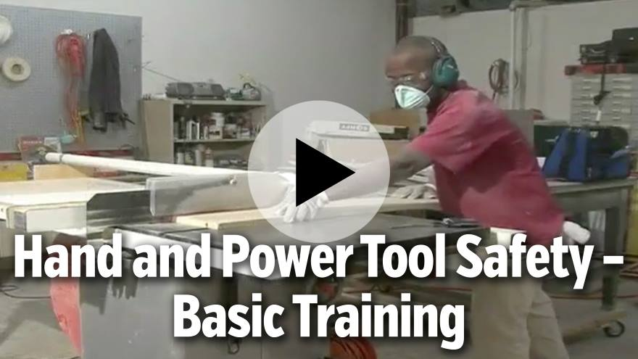
Reference: https://learn.streamery.co/Topics/Safety/OSHA-Compliance/Hand-Power-Tool-Safety/Hand-and-Power-Tool-Safety-Basic-Training-en

Slide 6
The Right Tool for the Job
Wrench: Use the proper wrench for the job and with the jaws in the direction of the pull. Never use it as a hammer.
Knife: Cut away and never toward your body. Knives and hand stones used to sharpen them should be equipped with disc guards to protect fingers.
Hammer: A machinist ball or cross and straight peen hammer are not suitable for driving nails; a carpenter’s claw hammer is not suitable for a machinist’s work.
Screwdriver: Do not use as a wedge, chisel, or punch. They should have proper handles and points in good condition.

Slide 7

Hammer Inspection
Make sure the hammer is free of oil, grease, and accumulated foreign material.
Check for damaged edges or irregularities on the striking surface.
Make sure the head is securely fastened to the handle.
Observe for any visible cracks in the head or handle.
Reference: www.osha.gov/sites/default/files/publications/osha3080.pdf

Slide 8

Wrench Inspection
Observe the jaws to see if they are worn, damaged, or out of proper alignment.
For tools with ratcheting mechanisms, does the ratchet operate properly and freely?
Make sure the adjusting nut of an adjustable wrench moves freely.
Check for any visible cracks in the jaws or handle.
Reference: www.osha.gov/sites/default/files/publications/osha3080.pdf

Slide 9
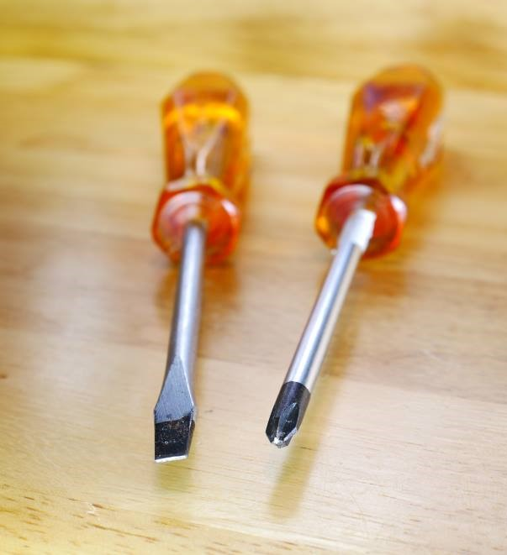
Screwdriver Inspection
Make sure the tip isn’t broken or worn.
Does the tip fit the screw snugly?
Check for any visible cracks in the tip, shaft, or handle.
Reference: www.osha.gov/sites/default/files/publications/osha3080.pdf

Slide 10

Pliers Inspection
Make sure the gripping surfaces of the jaws aren’t worn, damaged, or out of alignment.
Check the hinge of the pliers to make sure it moves freely.
For pliers with expandable hinges, confirm the hinge locks securely in place when the jaws are expanded.
Check for any visible cracks in the jaws or handle.
Reference: www.osha.gov/sites/default/files/publications/osha3080.pdf

Slide 11
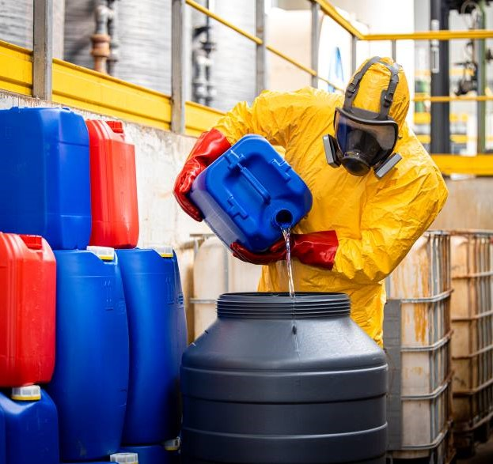
Personal Protective Equipment and Clothing
  Wear required personal protective equipment (PPE).
  Wear PPE in required work areas, even if only passing through.
  Ensure equipment and clothing fit correctly.
  Inspect and maintain PPE properly.
  Store PPE properly.
  Wear required personal protective equipment (PPE).
  Wear PPE in required work areas, even if only passing through.
  Ensure equipment and clothing fit correctly.
  Inspect and maintain PPE properly.
  Store PPE properly.
Reference: www.osha.gov/personal-protective-equipment

Slide 12

Lifting and Carrying Safely
Use a lifting aid when possible.
Never lift beyond your strength. Ask for help.
Always crouch down to what you are going to lift. Don’t bend over to the load.
Secure a good footing, placing your feet about shoulder width apart.
Reference: www.osha.gov/etools/electrical-contractors/materials-handling/heavy

Slide 13
Lifting and Carrying Safely (Continued)
Lift gradually. Don’t jerk upward.
Avoid twisting motions by shifting the position of your feet.
Lift by standing up or pushing up with your leg muscles. This takes the strain off your back muscles.
To put down a load, generally reverse the above methods.
Reference: www.osha.gov/etools/electrical-contractors/materials-handling/heavy

Slide 14
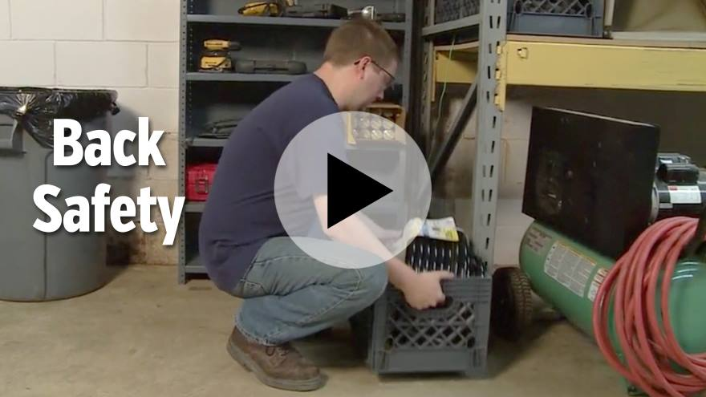
Reference: https://learn.streamery.co/Topics/Safety/Workplace-Safety/Back-Injury-Prevention/Back-Safety

Slide 15
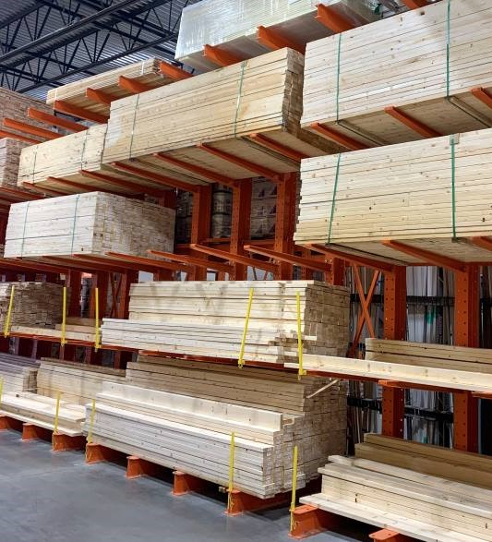
Material Storage Safety
Stack objects only to a safe height and ensure that the stack will remain steady.
Maintain at least 18 inches between the stack and any sprinkler heads.
Maintain a minimum of three feet clearance around electrical panels and service entries.
Keep storage areas free from accumulated material that can cause tripping, fire, and explosion or contribute to the harboring of pests.
Reference: www.osha.gov/sites/default/files/publications/osha2236.pdf

Slide 16
Material Storage Safety (Continued)
Store compressed gas cylinders on a smooth floor in an upright position with valve covers in place.
Cylinders should be fastened to a wall or stable surface to prevent displacement.
Materials should never be stored under stairs or within exit enclosures.
No item should be stored in stairways to impede egress.
Reference: www.osha.gov/sites/default/files/publications/osha2236.pdf

Slide 17
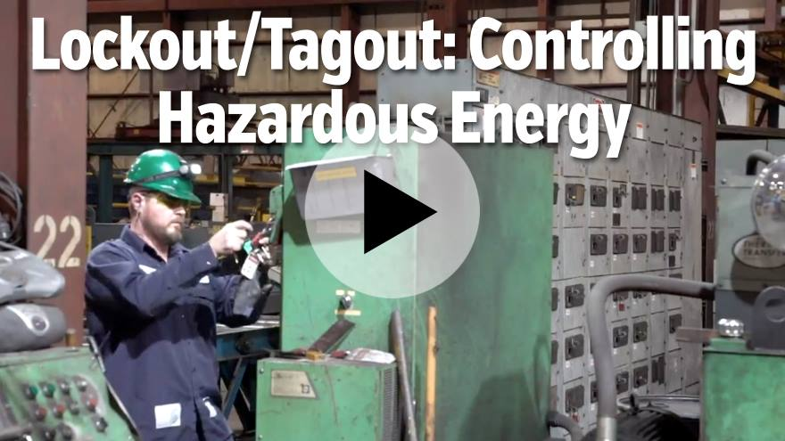
Reference: https://learn.streamery.co/Topics/Safety/OSHA-Compliance/Lockout-Tagout/Lockout-Tagout-Controlling-Hazardous-Energy

Slide 18

Material Handling Safety
  Assess your load and route.
  After proper training, choose the right equipment for the job:
    Hand truck
    Powered equipment
    Conveyor
    Hoist and derrick
  Load equipment safely.
  Push—don’t pull.
  Wear appropriate personal protective equipment.
Reference: www.osha.gov/sites/default/files/publications/osha2236.pdf

Slide 19
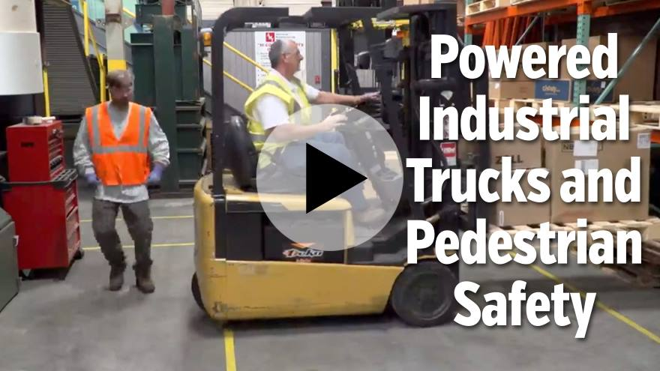
Reference: https://learn.streamery.co/Topics/Safety/OSHA-Compliance/Forklift-Safety/To-The-Point-About-PITs-and-Pedestrian-Safety

Slide 20

Ladder Safety
Maintain three points of contact while ascending or descending a ladder.
Face the ladder when ascending, descending, or working.
Use the correct ladder for the job and ensure that it is sturdy enough to hold the load.
Make sure the ladder is stable.
Inspect ladders before use. Check for loose, cracked, bent, missing, or broken steps/rungs, rails, and non-slip feet.
Damaged or worn ladders must be destroyed.
Reference: www.osha.gov/sites/default/files/publications/osha3124.pdf

Slide 21
Ladder Inspection
Inspect for damage, lack of structural integrity, missing components, or loose parts.
The steps or rungs must be tight and secure to the side rails.
All hardware and fittings must be properly and securely attached.
Test movable parts to make sure they operate without binding or too much free play.
Reference: www.dir.ca.gov/dosh/etools/08-001/care.htm

Slide 22
Ladder Inspection (Continued)
All labels should be intact and readable.
Ladders should be free of oil, grease, and slippery materials.
A ladder exposed to fire or strong chemicals must be discarded.
Leg levelers, paint shelves, stand-off shelves, etc. must be in good condition.
The base must be on secure and level footing. Use a ladder leveler for equal rail support on uneven surfaces.
Reference: www.dir.ca.gov/dosh/etools/08-001/care.htm

Slide 23
Ladder Inspection (Continued)
The base must have slip resistant material.
Ropes and pulleys must be in good condition.
Ladder extension locks must move freely and lock correctly.
Check for rung locks on the rails of the top section to ensure it will not fall.
Extension guide brackets must be secure and in place.
Reference: www.dir.ca.gov/dosh/etools/08-001/care.htm

Slide 24

Reference: https://learn.streamery.co/Topics/Safety/OSHA-Compliance/Ladder-Safety/A-Practical-Approach-to-Ladder-Safety-Concise-en

Slide 25

Hazard Communication
Hazardous materials present great risks. You have a right to know what materials are used in the workplace and what hazards they present.
A list of hazardous materials used in this facility will be provided for your review.
All containers must be labeled with safety information that lists the contents, name, and address of manufacturer or importer and specific hazards, including the degree of hazard.
Reference: www.osha.gov/sites/default/files/publications/OSHA3514.pdf

Slide 26
Hazard Communication (Continued)
A safety data sheet (SDS) with safety details is kept for every chemical used in our facility and can be accessed at any time.
Learn where to access our facility’s hazardous materials list and SDS and how to read them correctly.
Know where eyewash stations and showers are located.
Read the container label and its appropriate SDS before using any chemical.
Reference: www.osha.gov/sites/default/files/publications/OSHA3514.pdf

Slide 27

Reference: https://learn.streamery.co/Topics/Safety/OSHA-Compliance/HazCom-Right-to-Know/Hazard-Communication-The-GHS-You-Concise-en

Slide 28
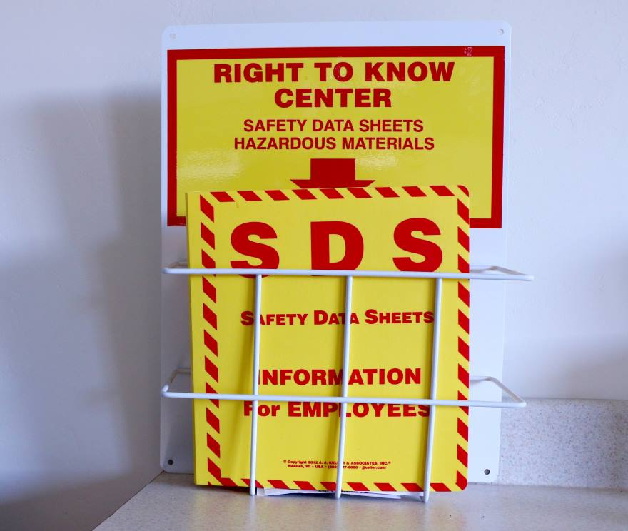
Know Where to Find Safety Data Sheets
Sections 1–8 contain general information about the chemical, identification, hazards, composition, safe handling practices, and emergency control measures (e.g., fire fighting) to help those who need the information quickly.
Sections 9–11,16 contain technical and scientific information, such as physical and chemical properties, stability and reactivity information, toxicological information, and exposure control information.
Reference: www.osha.gov/sites/default/files/publications/OSHA3514.pdf

Slide 29

Good Housekeeping
  Practice good housekeeping in your work area. You are responsible for keeping your area organized.
  Report areas in need of attention to your supervisor or a member of the safety committee. Clean up spills immediately.
  Return tools and other equipment to their proper storage place after use.
  Place empty boxes or wrappings in a cart or trash container to eliminate tripping hazards.
Reference: www.osha.gov/laws-regs/regulations/standardnumber/1915/1915.81

Slide 30
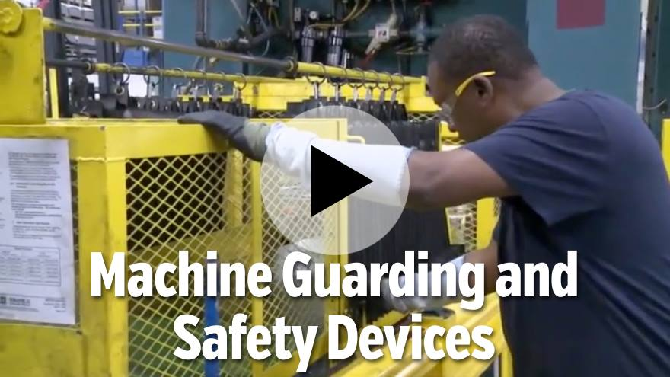
Reference: https://learn.streamery.co/Topics/Safety/OSHA-Compliance/Machine-Guarding/To-The-Point-About-Machine-Guarding-And-Safety-De

Slide 31

Slip, Trip, and Fall Hazards
  Power cords, ropes, and hoses across floors and walkways.
  Open-sided walkways and platforms.
  Clutter in walkways.
  Floor damage or holes and openings in walls.
  Open pits, tanks, vats, and ditches.
  Wet floors or stairs.
Reference: 29 C.F.R. §§ 1910.21, 1910.22, 1910.25, 1910.28, 1910.29 & 1910.30 (2024).

Slide 32
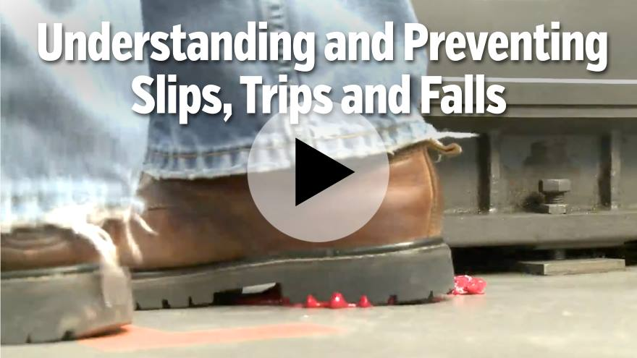
Reference: https://learn.streamery.co/Topics/Safety/OSHA-Compliance/Slips,-Trips,-Falls/Understanding-and-Preventing-Slips,-Trips-and-Falls

Slide 33

Safe Driving Tips
  Plan your route ahead of time and allow plenty of travel time.
  Use a seatbelt at all times.
  Keep your lights on and use turn signals.
  Be alert to situations requiring quick action.
  Avoid distractions and do not text while driving.
  Make sure your vehicle is inspected regularly.
  Plan your route ahead of time and allow plenty of travel time.
  Use a seatbelt at all times.
  Keep your lights on and use turn signals.
  Be alert to situations requiring quick action.
  Avoid distractions and do not text while driving.
  Make sure your vehicle is inspected regularly.
Reference: www.osha.gov/sites/default/files/publications/Safe_Driving_Practices.pdf

Slide 34
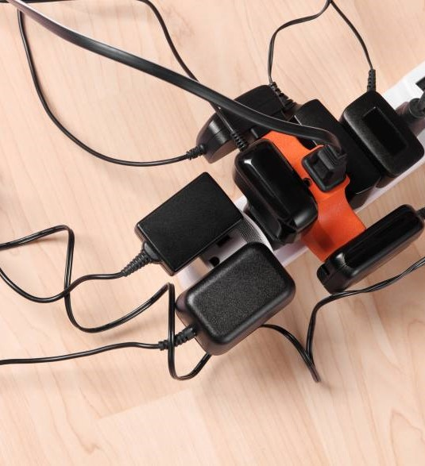
Basic Electrical Safety
Damaged outlets and loose or missing covers should be replaced immediately.
Report any exposed wiring.
Use ground-fault circuit interrupter (GFCI) outlets near sinks.
Keep electrical panels closed and clear of obstruction.
Wear correct PPE.
Inspect electrical cords for exposed wires or missing ground plug.
Reference: www.osha.gov/electrical

Slide 35
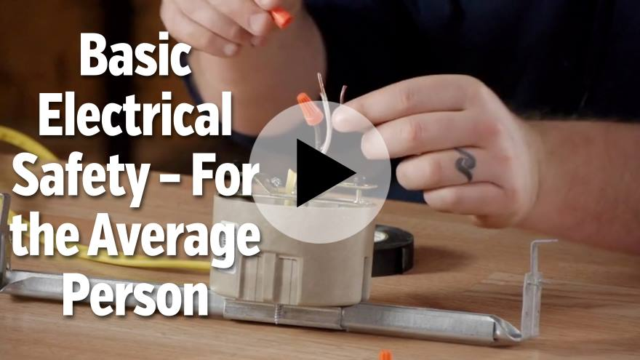
Reference: https://learn.streamery.co/Topics/Safety/OSHA-Compliance/Electrical-Safety/Basic-Electrical-Safety-For-the-Average-Person

Slide 36

Common Fire Hazards
  Office equipment and supplies
  Electrical wires and equipment
  Flammable materials
Reference: www.osha.gov/fire-safety/hazards-solutions

Slide 37

Fire Response
  Know where fire extinguishers are located.
  Use the right extinguisher for the job.
  Know how to use a fire extinguisher:
    Pull the pin
    Aim hose at fire base
    Squeeze trigger
    Sweep hose back and forth
Reference: www.osha.gov/laws-regs/regulations/standardnumber/1926/1926.150

Slide 38
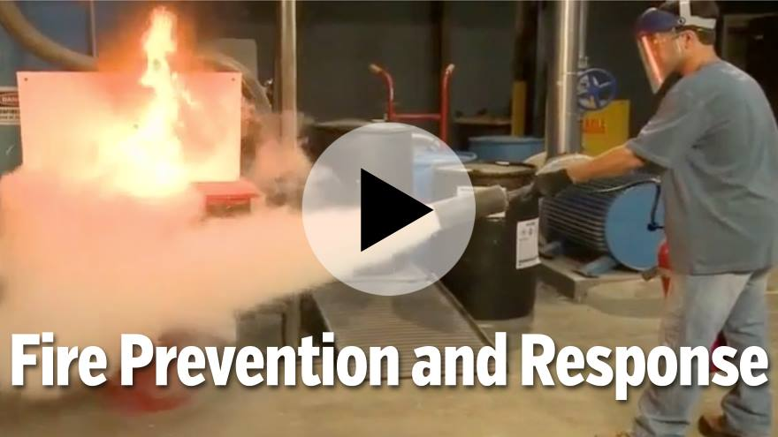
Reference: https://learn.streamery.co/Topics/Safety/OSHA-Compliance/Fire-Evacuation-Prevention/To-The-Point-About-Fire-Prevention-Response

Slide 39

First Aid Response
Contact a trained first-aid provider if someone is injured.
Use eye wash stations for chemical exposure to eyes.
Locate the first-aid box near your work area.
Consult the safety data sheet if exposed to spills or chemical releases.
Protect against blood-borne pathogens.
Reference: www.osha.gov/laws-regs/regulations/standardnumber/1910/1910.151

Slide 40
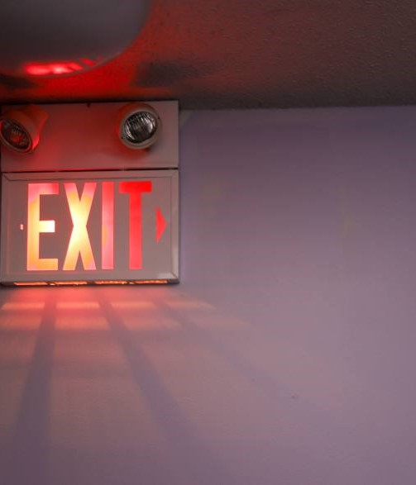
Evacuation Procedures
  Recognize evacuation
  signals.
  Listen for instructions.
  Shut down equipment.
  Follow nearest safe exit route.
  Proceed to assembly area.
Reference: www.osha.gov/etools/evacuation-plans-procedures/eap/minimum-requirements

Slide 41
New Employee Orientation Tour
First-aid kit location and instructions
Eye wash station location and instructions
Fire extinguisher location and instructions
Entry and exit points
Evacuation plan and routes
Area hazards (furnace or confined space)
PPE required areas

Slide 42

Pamphlet Review

Slide 43

Your Safety Orientation Is Complete
Any Questions?
March 2026

Slide 44

The information presented in this publication is intended to provide guidance and is not intended as a legal interpretation of any federal, state or local laws, rules or regulations applicable to your business. The loss prevention information provided is intended only to assist policyholders of Summit managed insurers in the management of potential loss producing conditions involving their premises and/or operations based on generally accepted safe practices. In providing such information, Summit Consulting LLC does not warrant that all potential hazards or conditions have been evaluated or can be controlled. It is not intended as an offer to write insurance for such conditions or exposures. The liability of Summit Consulting LLC and its managed insurers is limited to the terms, limits and conditions of the insurance policies underwritten by any of them.
3/26 (25-341) ©2026 Summit Consulting LLC (DBA Summit. Know the people who know workers’ comp. LLC) PO Box 988, Lakeland, FL 33802. All rights reserved.

