Slide 1
New Employee
Safety Orientation
Construction
October 2024
Notes:
Presenter Notes
This training contains several training videos. You will need your username and password to access Summit’s online safety training videos, provided by Streamery. Visit our website to request login credentials.

Slide 2
Construction Injury Statistics
Approximately 5,000 workers die on the job every year¹
951 of 5,190 fatalities in 2021 (18.3%) involved construction workers¹
47% of construction injuries happen to first year employees (compared to 34% for all workers)²
References
https://www.bls.gov/news.release/pdf/cfoi.pdf
https://www.hcamag.com/us/specialization/workplace-health-and-safety/which-workers-are-most-likely-to-be-injured-at-work/444579

Slide 3

Safety Starts with a Strong Foundation
Notes:
Talking points
All successful safety programs begin with a strong foundation, including new-hire safety training.
What is your role as a new employee in helping to keep this foundation strong?

Slide 4

Your Role in Safety
    Your role in safety is to:
    Participate in safety training
    Identify hazards
    Report hazards, incidents and near misses
    Maintain an attitude of safety
    Ask for help
This will help create a safe work environment for everyone.
Reference: www.osha.gov/safety-management/worker-participation
Notes:
Talking points
You play an important role in the safety of this workplace. The goal of our safety policy is to help you work safely in a safe work environment, while maintaining a high level of production.
To achieve this goal, we need you to:
Continue to participate in all required safety training sessions.
Report any hazards and unsafe conditions you see. Report any incidents and near misses that occur. We need to know about problems, so that we can investigate their causes and make necessary changes.
Remember that you play a big role in the successful implementation of safety in our organization. Always keep a safety attitude and encourage others to also.
Ask your supervisor for help any time you are not sure how to proceed safely.
Make sure you’re familiar with your facility’s written safety policy. Know where to obtain and how to fill out hazard or accident report forms.
Presenter notes
Describe your company’s written safety policy.
Hand out the policy or refer to it in the employee manual.
Describe your company’s safety record. Emphasize improvements in reducing incidents and ongoing efforts to make the workplace safer.
Hand out or refer to your organization’s hazard report and incident report forms.

Slide 5
General Safety Rules
Obey warning signs.
Follow safety procedures.
Do not take shortcuts.
Do not engage in horseplay.
Use common sense.
Notes:
If you have a workplace handout on safety rules and procedures, give it to participants now and discuss the list.

Slide 6

Use Common Sense
Follow the safety rules—use common sense and do not engage in horseplay.

Slide 7
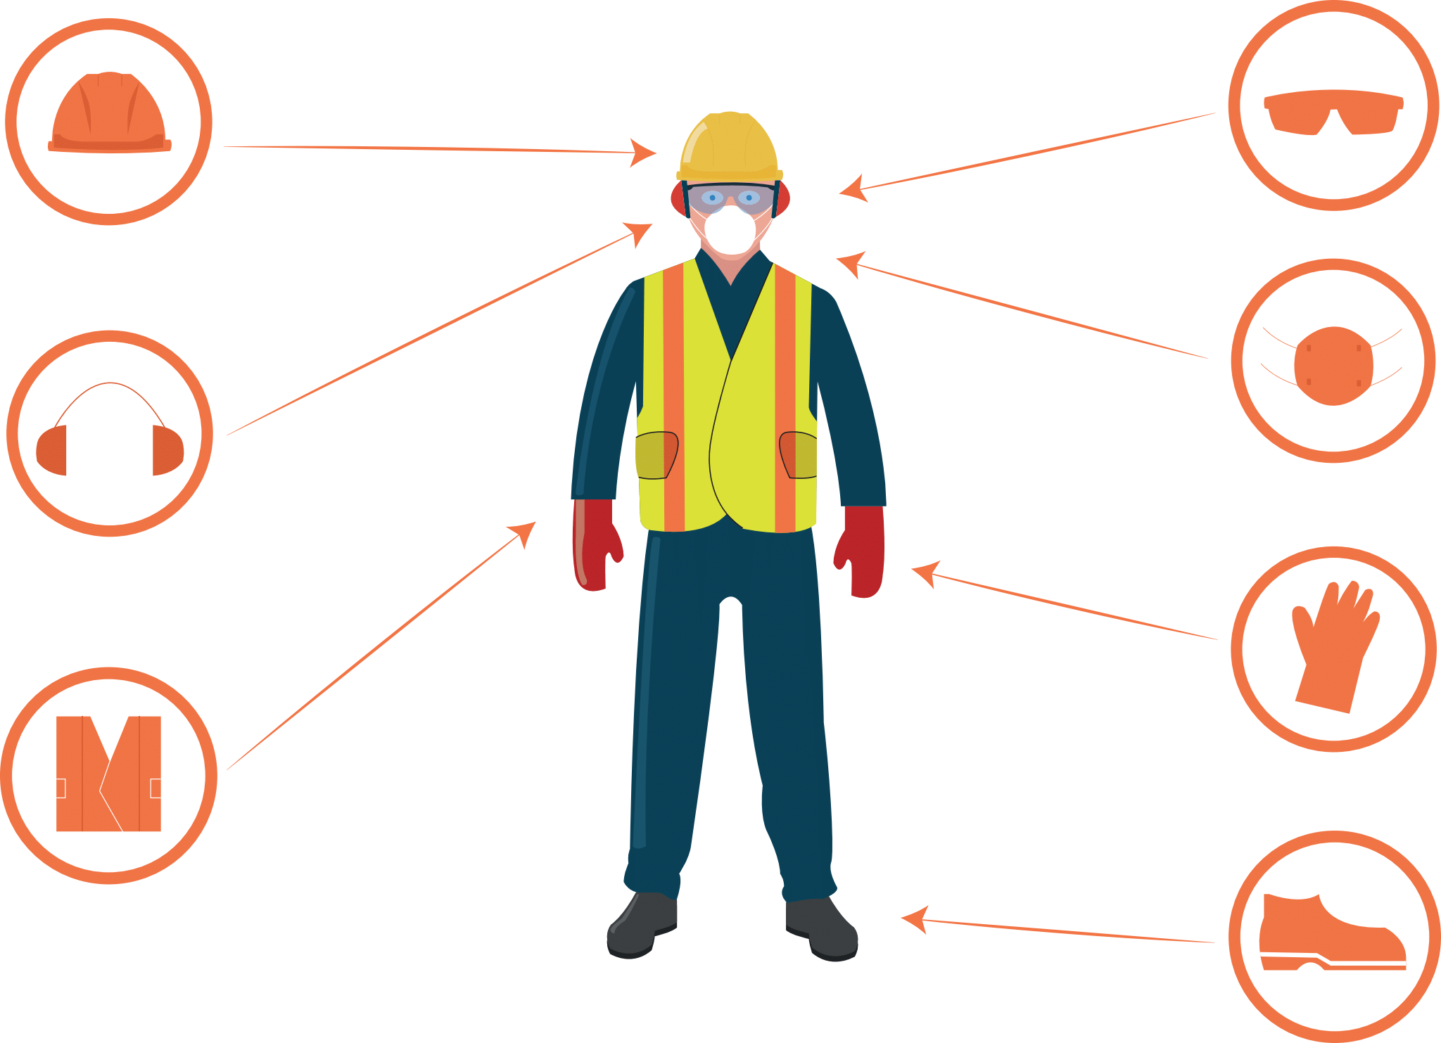
Personal Protective Equipment and Clothing
  Wear required personal protective equipment (PPE).
  Ensure equipment and clothing fit correctly.
  Inspect and maintain PPE properly.
  Store PPE properly.
Reference: www.osha.gov/personal-protective-equipment
Notes:
Talking points
Personal protective equipment (PPE) and clothing are required for certain jobs.
Make sure you know when and where you’re required to wear PPE.
Also, make sure you know how to get a good fit and how to inspect, maintain, clean and store PPE.

Slide 8

Hand Tool Safety
Return tools to their proper storage place after use.
Repair and clean defective tools to keep them in good working condition.
Use the correct tool for the job.
Reference: www.osha.gov/sites/default/files/publications/osha3080.pdf
Notes:
Discuss company-specific policies/rules regarding hand tools.

Slide 9
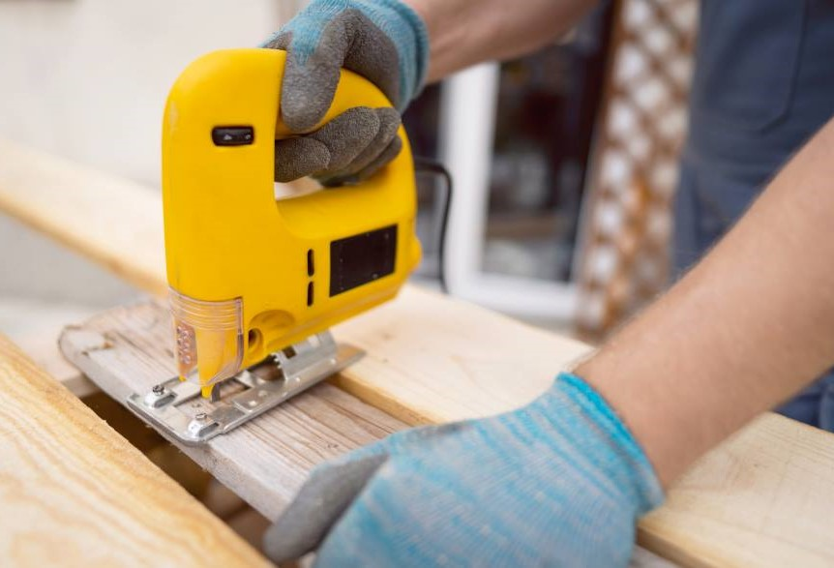
Power Tool Safety
Tuck in your shirt and avoid wearing loose-fitting clothing or jewelry.
Inspect tools for cracks, damaged cords or plugs, and exposed wires.
Make sure all guards are in place and in good working condition.
Reference: www.osha.gov/sites/default/files/publications/osha3080.pdf
Notes:
Discuss company-specific policies/rules regarding power tools.

Slide 10
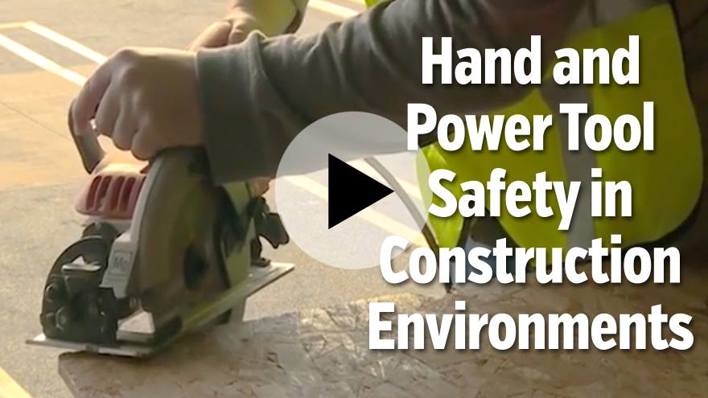
Reference: https://learn.streamery.co/Topics/Safety/Construction-Safety/Hand-Power-Tool-Safety/Hand-and-Power-Tool-Safety-in-Construction-Environments
Notes:
You will need your username and password to access Summit’s online safety training videos, provided by Streamery. Visit our website to request login credentials.

Slide 11
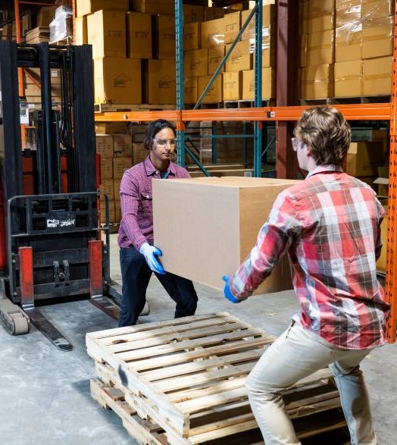
Lifting and Carrying Safely
Use your leg muscles—not your back muscles—to lift.
Face the load (do not twist your back) and make sure your walking path is clear.
Use a cart or dolly when carrying a load for a long distance.
Ask for help or use a mechanical lifting device when moving heavy and/or awkward items.
Reference: www.osha.gov/etools/electrical-contractors/materials-handling/heavy
Notes:
Discuss company-specific policies/rules regarding lifting and carrying.

Slide 12
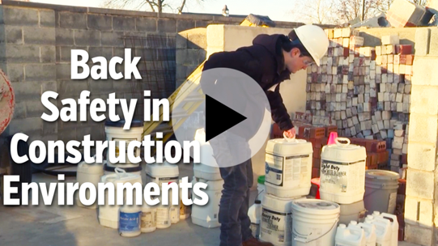
Reference: https://learn.streamery.co/Topics/Safety/Construction-Safety/Back-Safety/Back-Safety-in-Construction-Environments
Notes:
You will need your username and password to access Summit’s online safety training videos, provided by Streamery. Visit our website to request login credentials.

Slide 13
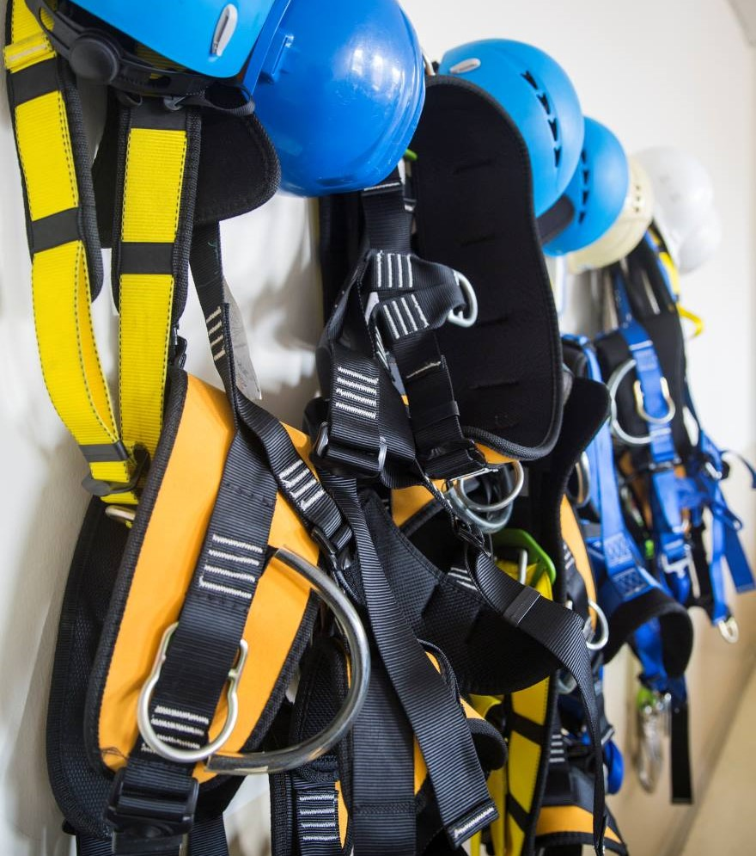
Fall Prevention
Guard or cover all floor holes, openings and skylights.
Wear a body harness and stay connected when working at heights above six feet.
Inspect your body harness before use. Look for loose threads, burns, cuts, abrasions or wear and tear.
Reference: www.osha.gov/fall-protection
Notes:
Discuss company-specific policies/rules regarding fall prevention.

Slide 14
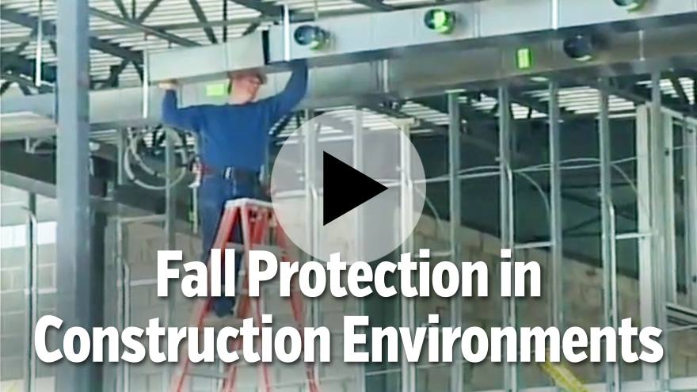
Reference: https://learn.streamery.co/Topics/Safety/Construction-Safety/Fall-Protection/Fall-Protection-in-Construction-Environments
Notes:
You will need your username and password to access Summit’s online safety training videos, provided by Streamery. Visit our website to request login credentials.

Slide 15

Scaffolding Safety
A competent person must supervise the building, moving and dismantling of scaffolding.
Inspect scaffolding before each shift. Consider using a scaffolding safety checklist.
Be aware of load limits. Scaffolding and its components are made with precise load-bearing capacities.
Reference: www.osha.gov/scaffolding
Notes:
Discuss company-specific policies/rules regarding scaffolding.

Slide 16
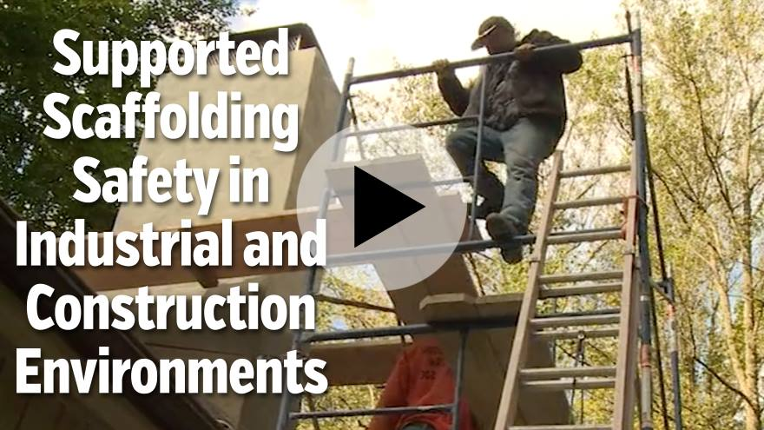
Reference: https://learn.streamery.co/Topics/Safety/Construction-Safety/Scaffolding/Supported-Scaffolding-Safety-in-Industrial-and-Construction-Environments
Notes:
You will need your username and password to access Summit’s online safety training videos, provided by Streamery. Visit our website to request login credentials.

Slide 17

Ladder Safety
Always maintain three points of contact while ascending or descending a ladder.
Always face the ladder when ascending, descending or working.
Use the correct ladder for the job. Ensure proper ladder height and load capacity.
Reference: www.osha.gov/sites/default/files/publications/osha3124.pdf
Notes:
Discuss company-specific policies/rules regarding ladders.

Slide 18
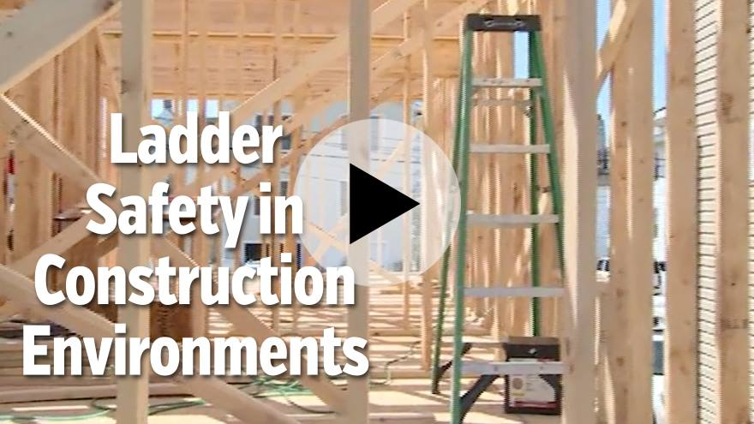
Reference: https://learn.streamery.co/Topics/Safety/Construction-Safety/Ladder-Safety/Ladder-Safety-In-Construction-Environments-en
Notes:
You will need your username and password to access Summit’s online safety training videos, provided by Streamery. Visit our website to request login credentials.

Slide 19

Housekeeping Rules
You are responsible for keeping your work area clean and organized.
Report areas in need of attention to your supervisor or foreman.
Return tools and equipment to their proper storage place after use.
Reference: www.osha.gov/laws-regs/regulations/standardnumber/1915/1915.81
Notes:
Discuss company-specific policies/rules regarding housekeeping.

Slide 20
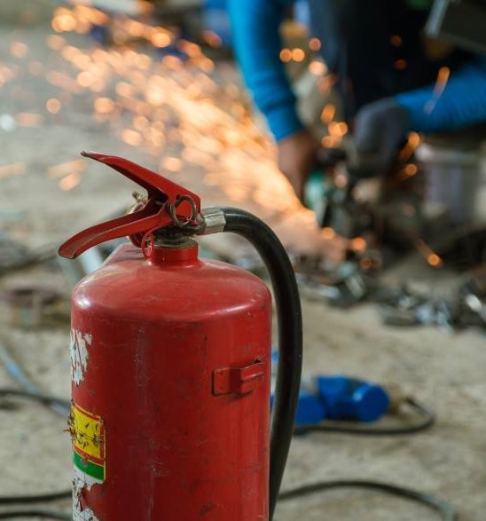
Fire Safety
Report all fire hazards immediately.
Flammable liquids must be stored in approved containers.
Inspect fire extinguishers to ensure readiness and access to them.
Reference: www.osha.gov/laws-regs/regulations/standardnumber/1926/1926.150
Notes:
Discuss company-specific policies/rules regarding fire safety.

Slide 21
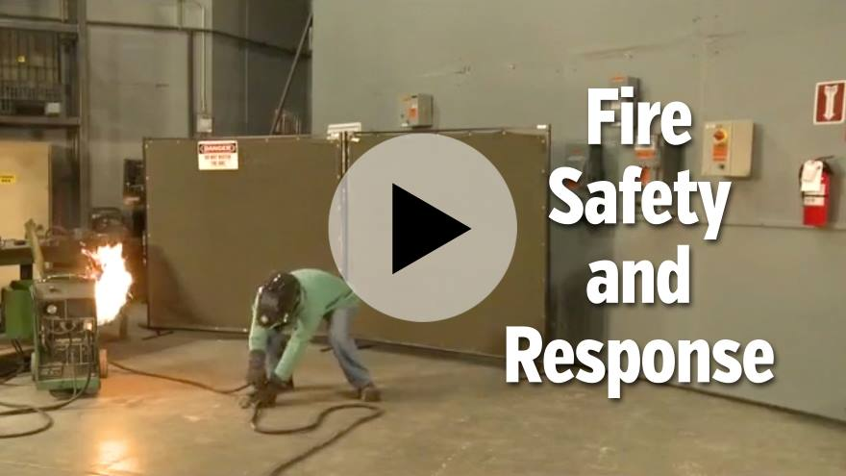
Reference: https://learn.streamery.co/Topics/Safety/OSHA-Compliance/Fire-Evacuation-Prevention/To-The-Point-About-Fire-Prevention-Response
Notes:
You will need your username and password to access Summit’s online safety training videos, provided by Streamery. Visit our website to request login credentials.

Slide 22
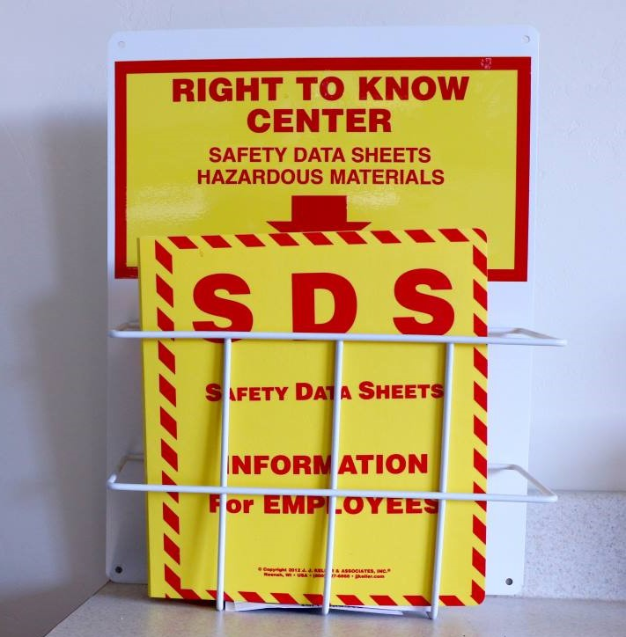
Hazard Communication
You have a right to know what materials are used on the job and what hazards they present.
Know where the Safety Data Sheets are located.
All containers must be labeled with safety information that lists the contents, name and address of manufacturer or importer and specific hazards.
Reference: www.osha.gov/sites/default/files/publications/OSHA3514.pdf
Notes:
Discuss company-specific policies/rules regarding hazard communication.

Slide 23
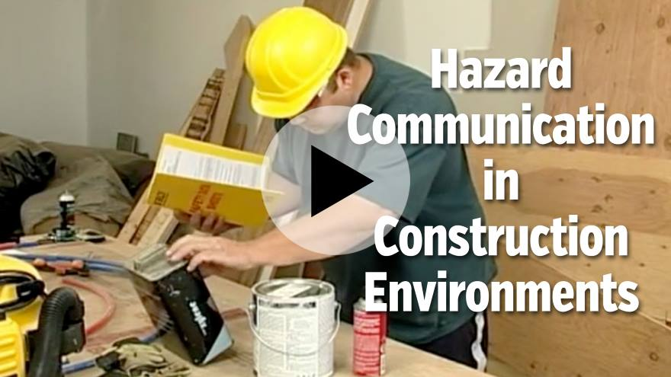
Reference: https://learn.streamery.co/Topics/Safety/Construction-Safety/HazCom-Right-to-Know/Hazard-Communication-in-Construction-Environments
Notes:
You will need your username and password to access Summit’s online safety training videos, provided by Streamery. Visit our website to request login credentials.

Slide 24

Electrical Safety
Assume that all electrical circuits and equipment are live.
Inspect all tools, cords and plugs, and repair (if qualified) or replace if damaged.
Contact your foreman or safety director if an electrical safety hazard exists.
Reference: www.osha.gov/sites/default/files/publications/OSHA3942.pdf
Notes:
Discuss company-specific policies/rules regarding electrical safety.

Slide 25
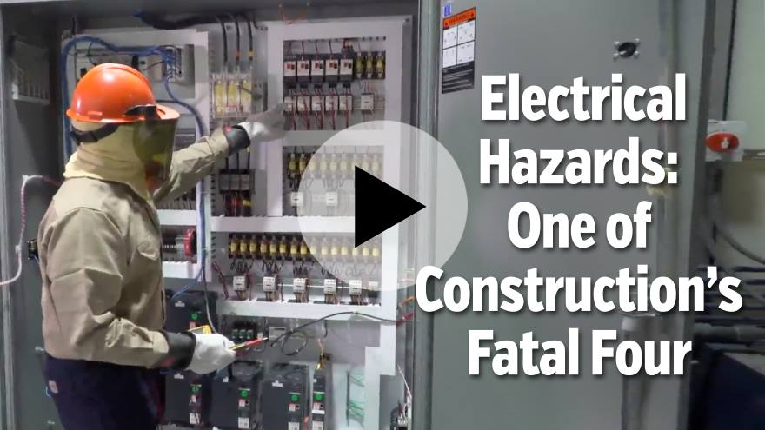
Reference: https://learn.streamery.co/Topics/Safety/Construction-Safety/Safety-Orientation/Electrical-Hazards-One-of-Construction-s-Fatal-Four
Notes:
You will need your username and password to access Summit’s online safety training videos, provided by Streamery. Visit our website to request login credentials.

Slide 26
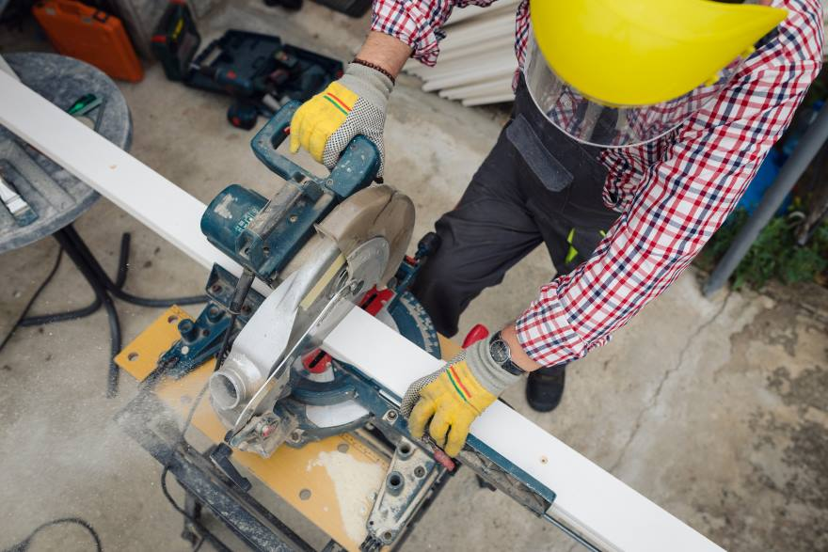
Safety Device Restrictions
Removing or changing the operation of any safety device is prohibited.
Under no circumstances is anyone authorized to bypass safety features.
Only trained or authorized persons should adjust safety controls.
Reference: www.osha.gov/laws-regs/regulations/standardnumber/1926/1926.702
Notes:
Discuss company-specific policies/rules regarding safety device restrictions.

Slide 27

Preventing Slips, Trips and Falls
Use handrails and walk—don’t run—when going up or down stairs.
Pick up all tools, materials and trash. Dispose of trash in the appropriate on-site container.
Keep power cords out of traffic areas (walkways, stairwells, heavy equipment routes, etc.).
Reference: 29 C.F.R. §§ 1910.21, 1910.22, 1910.25, 1910.28, 1910.29 & 1910.30 (2024)
Notes:
Discuss company-specific policies/rules regarding slips, trips and falls.

Slide 28
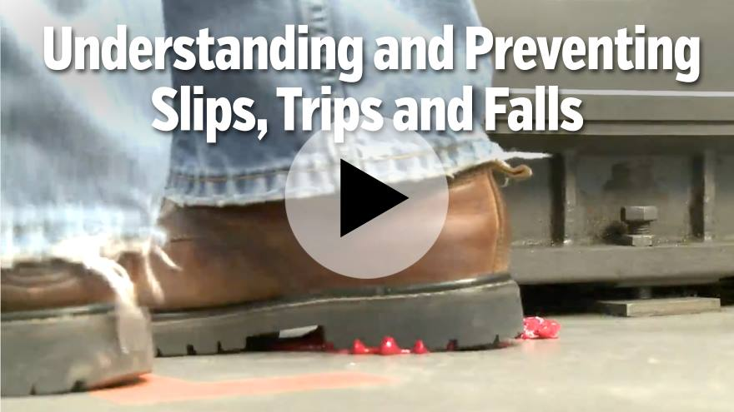
Reference: https://learn.streamery.co/Topics/Safety/OSHA-Compliance/Slips,-Trips,-Falls/Understanding-and-Preventing-Slips,-Trips-and-Falls
Notes:
You will need your username and password to access Summit’s online safety training videos, provided by Streamery. Visit our website to request login credentials.

Slide 29

Excavation Safety
A competent person must be on site when an excavation exists.
Use sloping, shoring, shielding and/or benching to protect those who work in trenches.
A competent person must inspect the excavation daily—before worker entry and when conditions change, such as after a storm.
Reference: www.osha.gov/sites/default/files/publications/trench_excavation_fs.pdf
Notes:
Discuss company-specific policies/rules regarding excavations.

Slide 30
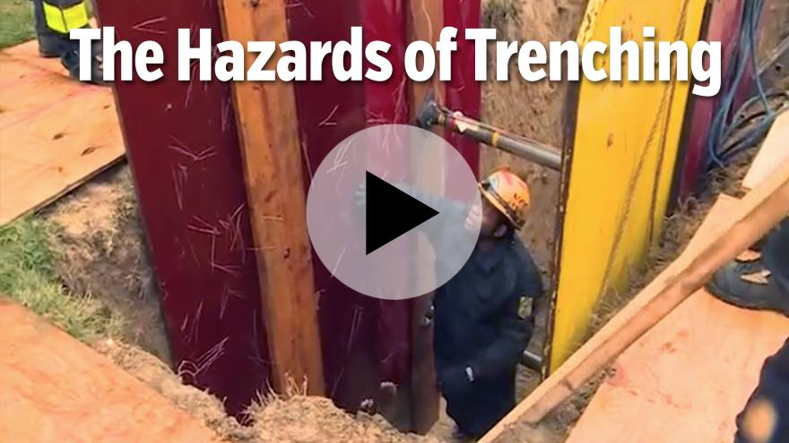
Reference: https://learn.streamery.co/Topics/Safety/Construction-Safety/Trenching-Shoring/Trenching-and-Shoring-Safety-in-Construction-Envir
Notes:
You will need your username and password to access Summit’s online safety training videos, provided by Streamery. Visit our website to request login credentials.

Slide 31

Pamphlet Review
Notes:
Skip over this slide if you are not reviewing Summit’s new-hire pamphlet for the Construction Industry.

Slide 32

Your Safety Orientation Is Complete
Any questions?
Notes:
Conduct Q & A

Slide 33
Summit is a leading regional provider of workers’ compensation services with more than 40 years of experience.
Visit summitholdings.com to learn more.
The information presented in this publication is intended to provide guidance and is not intended as a legal interpretation of any federal, state or local laws, rules or regulations applicable to your business. The loss prevention information provided is intended only to assist policyholders of Summit managed insurers in the management of potential loss producing conditions involving their premises and/or operations based on generally accepted safe practices. In providing such information, Summit Consulting LLC does not warrant that all potential hazards or conditions have been evaluated or can be controlled. It is not intended as an offer to write insurance for such conditions or exposures. The liability of Summit Consulting LLC and its managed insurers is limited to the terms, limits and conditions of the insurance policies underwritten by any of them.
5/24 (23-282) ©2024 Summit Consulting LLC (DBA Summit. Know the people who know workers’ comp. LLC) PO Box 988, Lakeland, FL 33802. All rights reserved.

